Slide 1
Software Engineering
Weekly report <OnMyWay>
Bushra Ahmad
Shahrukh Sultan
04/03/2021

Slide 2
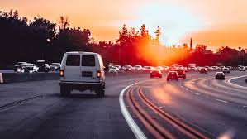
Project CHARTER
You want to go from area to another in your country and you are alone at your car and you have a free seats .
Why you don’t take some people with you as a way of helping and kind of amusement.

Slide 3
Project goals and vision
Actually there are two important goals to us from this application :
1- let people helping themselves by this type of application.
2- maybe this project isn’t a big project but this subject in this semester will be the first step in software developing world for us so when we apply this application and every thing is ok that mean a lot for us.

Slide 4




What the Architecture for designing:

Slide 5
Flutter framework
Flutter is an open source software for a suite of software development tools developed by Google to build user interfaces for Android and iOS system applications.

Slide 6

Why dart language:
One of our aim in this course work is to learn Dart language for coding .
As we know this language :
1-Ease of learning You won't waste much time while you are learning it
2-A very flexible language in the sense that you can run it anywhere without any restrictions. You can run Dart applications. For mobile devices on Android - IOS. You can run web applications that you create on any browser
3-Multi-platform.
4-under developing

Slide 7
Organizational Structure
Project/Delivery Manager
<Name>
Customer
<people>
Team 1 <Bushra Ahmad
Shahrukh sultan>
Team Lead <Name>
Analysts: N
Developers:N
Testers: N
CMs: N
Team 2 <Name>
Team Lead <Name>
Analysts: N
Developers:N
Testers: N
CMs: N
Notes:
CRM – customer relationship manager / teacher

Slide 8
Коммуникационная Модель / Communication Model
<regular meetings and communications>

Slide 9
Key Accomplishments For Reporting Period
<documentation
<coding>
<testing>

Slide 10
Выполнение Графика /Schedule Accuracy
Past Accomplishments | Plan | Actual
<Task/Milestone> | DD-MMM-YYYY | DD-MMM-YYYY
Future Milestones | % | Plan | Forecast
<Task/Milestone> | <n>% | DD-MMM-YYYY | DD-MMM-YYYY
Notes:
Provide milestone tracking data in your own form used in project.
Use proposed table in case you have no special form for milestone tracking

Slide 11
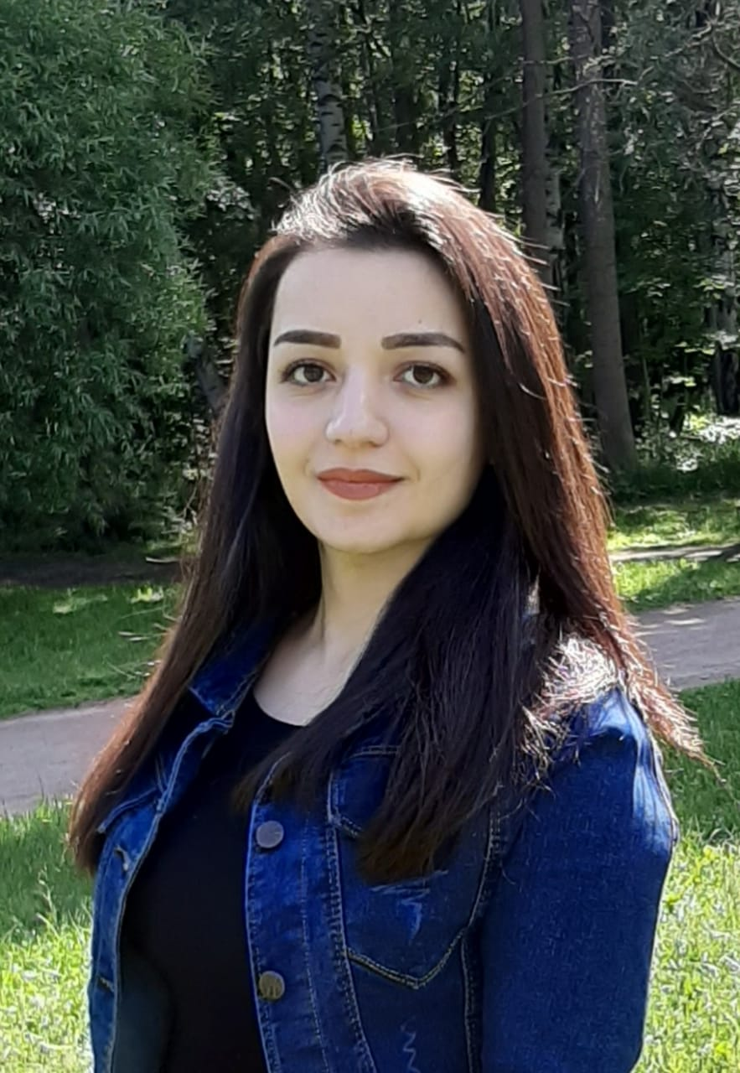
Team member 1
Bushra Ahmad

Slide 12
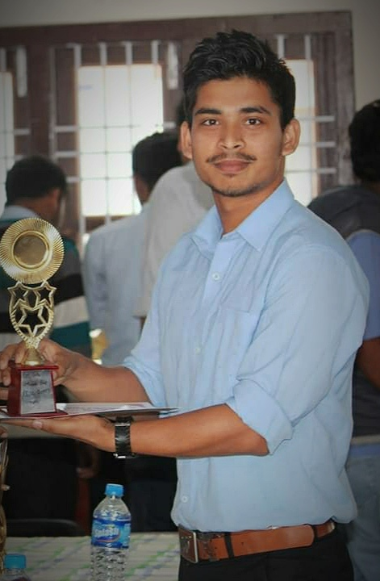
Team member 2
Shahrukh Sultan

Slide 13
Проектная команда / Staffing
24.02.16 02.03.16 09.03.16 16.03.16 23.03.16 30.03.16 06.04.16 13.04.16 20.04.16 27.04.16
<Trends analysis>

Slide 14
Разработка
<Trends analysis>

Slide 15
Тестирование
<Trends analysis>

Slide 16
Метрики по качеству
The project has to finish during 3 months

Slide 17
Риски и Проблемы / Risks and Issues
I think we will find some difficults with server and coding.

Slide 18
Thanks for attending

